Slide 1

Crime Classification
Prediction in Toronto
Group # 3
DAB422-24W-001: Capstone II
Prof. Abiodun Sodiq Shofoluwe

Slide 2




Capstone II
Group #3 – Team members
Srilakshmi Gummadidala
Vinod Soloman Santhakumar
Tehsin Shaikh
Yen Nga Le

Slide 3
Introduction
Crime, as a pervasive social issue, profoundly impacts individuals and communities, necessitating a comprehensive approach towards prevention and intervention. This project delves into crime in Toronto, acknowledging its impact on communities and emphasizing the importance of comprehensive prevention strategies for promoting community well-being.
Amidst rising crime rates, this project prioritizes understanding crime trends and prevention methods. Through reliable data analysis, we aim to support investigation agencies and enhance safety for all residents.
By analyzing crime factors and high-crime areas, along with evaluating current prevention methods, the project aims to reduce major crimes and improve public safety. Ultimately, our goal is to create a safer and more secure community for Toronto's diverse population.

Slide 4

Essential Steps in Crime Analysis
Our journey through the crime rate analysis project unfolds in nine pivotal steps:
Define the Business Problem and Identify Stakeholders
Identify Data Sources and Collect Relevant Data
Clean and Prepare Data for Analysis
Conduct Exploratory Data Analysis (EDA)
Perform Feature Engineering and Data Preprocessing
Implement Data Modeling Techniques
Interpret Model Results
Deploy the Model
Conclusion

Slide 5
Problem Statement and Identify Stakeholders
Understanding the Business Problem
Business Problem: Our project aims to delve deep into the crime trends within the city of Toronto. By analyzing extensive crime data, we focus on identifying patterns, hotspots, and factors influencing crime rates.
Key Stakeholders
Law Enforcement Agencies: Utilize findings to strategize and implement effective policing.
Policymakers: Make informed decisions to enhance public safety regulations and resource allocation.
Community Organizations: Use insights for community awareness and preventive measures.
Residents of Toronto: Direct beneficiaries of improved safety and security measures in the city.

Slide 6
Data Collection and Methodology
Data Collection
Data Fields
Data Cleaning
Methodology
Exploratory Data Analysis
Temporal Trends
Major Crime Categories
Police Division Analysis
Hourly Distribution
Neighborhood Crime Rates
Premises Type and Day of Week Trend Analysis
Feature Engineering/Data Preprocessing
Utilizing
Utilizing Encoding Techniques
Eliminating
Eliminating Irrelevant and Duplicate Columns
Scaling
Scaling Data
Notes:
Data Collection
The dataset is provided by the Toronto Police Service and can be accessed through the Toronto Public Safety Portal. The portal aims to promote transparency and public awareness regarding crime in the city.
Data Fields
The dataset includes various variables that provide information about each crime incident such as date and related offences, categories include Assault, Break and Enter, Auto Theft, Robbery and Theft Over, Premises type, location, neighborhood, latitude, and longitude, etc.
Data Cleaning
Removed missing values from the dataset and redundant columns. Filtered the dataset to include records only from the years 2014 to 2023 due to limited availability of records from 2003 to 2013.
Methodology
Data Preprocessing using Python Libraries:
Python libraries played a crucial role in refining our raw datasets for analysis. These preprocessing steps were pivotal in preparing a clean and standardized dataset, laying the foundation for our subsequent machine learning model.
Data Visualization with Tableau:
Using Tableau, we crafted interactive visualizations showcasing crime trends over time and space. Demographic insights and the exploration of environmental factors were seamlessly portrayed, providing a comprehensive understanding of the contextual elements influencing criminal activity.
Key Insights
Temporal Trends:
Crime events increased from 2014 to 2023, with fluctuations suggesting influencing factors.
Major Crime Categories:
Assault is most frequent, followed by Break and Enter, Auto Theft, Robbery, and Theft Over.
Police Division Analysis:
Certain divisions show significantly higher crime rates, requiring targeted interventions.
Hourly Distribution:
Peak and off-peak hours of criminal activity identified for resource deployment.
Neighborhood Crime Rates:
Assault dominant across neighborhoods, with localized variations in other crime types.
Premises Type and Day of Week Trend Analysis:
Outdoor areas, apartments, and commercial establishments have higher crime rates with peaks on Fridays and weekends.
Feature Engineering:
Utilizing Encoding Techniques:
Mapping categorical variables to numerical values to enable processing by machine learning algorithms.
Eliminating Irrelevant and Duplicate Columns:
Certain redundant features like 'OFFENCE' and 'LOCATION_TYPE' were eliminated from the dataset to streamline it, enhancing manageability and focus for further analysis.
Scaling Data:
Scaling data involves normalizing numerical features, excluding the target variable, to maintain a consistent scale between 0 and 1, thus preventing bias from features with larger magnitudes.

Slide 7
Overview of the Data Modeling phase
Leveraging machine learning to predict future crime rates via historical data analysis.
Process involves algorithm selection, data division into training/testing sets, model training, and performance evaluation.
Models include Random Forest Classifier, Logistic Regression, Neural Networks, Time Series, and utilized Lazy Predict method.
Comparison based on accuracy, interpretability, and computational efficiency.
Refining models to improve accuracy and robustness.
Aim to identify the most effective model for deployment.
Iterative refinement and evaluation to inform proactive crime prevention measures.

Slide 8
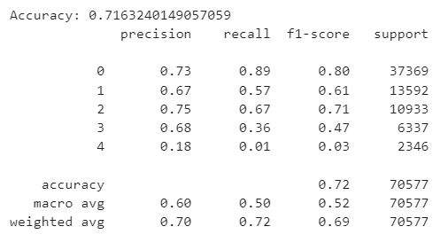
Random Forest Classifier Model(Base Model)
Utilized Random Forest Classifier, an ensemble learning method, for crime rate prediction.
Split dataset into features (X) and target variable (y) representing Major Crime Indicators (MCI) categories.
Divided data into 80:20 training/testing sets with random_state=42 for reproducibility.
Achieved approximately 72% accuracy.
Some categories, like Auto Theft, showed lower precision and recall scores due to imbalanced data representation.
Overall, the Random Forest Classifier demonstrates reasonable predictive capabilities with potential for further optimization.
Labels: 0 – Assault, 1 – Robbery, 2 – Break & Enter, 3 – Theft Over, 4 – Auto Theft

Slide 9
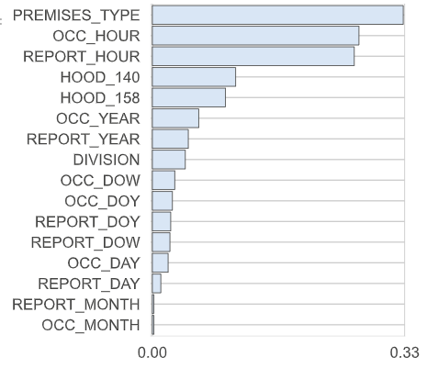
Feature Importances
We have utilized various feature importance methods to identify the most critical features for our modeling process.
By employing these methods, we aim to mitigate bias and overfitting that may arise from relying solely on a baseline random forest model.

Slide 10
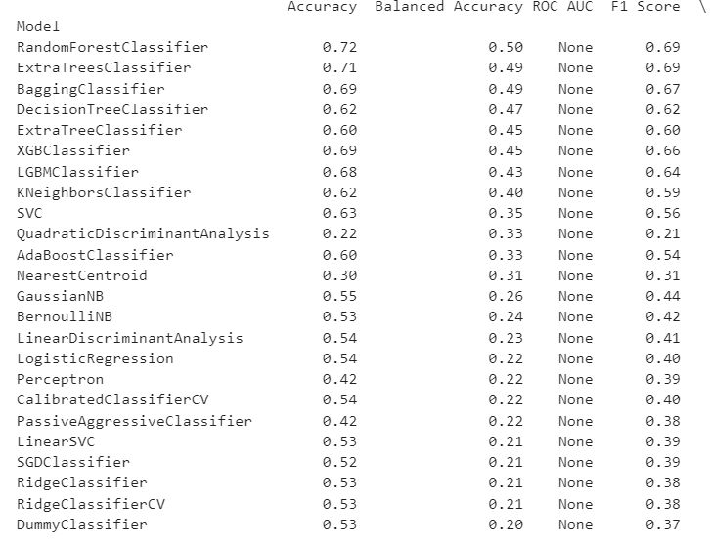
Lazy Predict Method
Lazy Predict method offers quick performance overview of classifier models without extensive manual configuration.
Enables comprehensive comparison of multiple models for quick identification of effective ones.
Top-performing models achieve high accuracies, some reaching 100%.
Less reliable models exhibit lower accuracy scores.

Slide 11
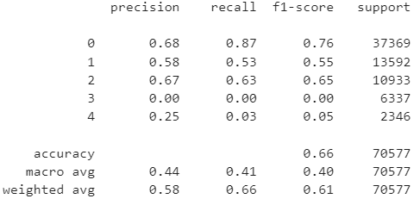
Neural Networks(Fully Connected)
Even with optimized hyperparameters, our classification models achieved average accuracy scores, raising concerns about their predictive ability.
To address this, we advanced towards employing fully connected neural networks, leveraging their ability to handle complex data structures more effectively.
Used TensorFlow and Kera's for Neural Networks modeling.
Built Sequential model with dense and dropout layers.
Split dataset into 80% training and 20% testing sets.
Encoded target variable using Label Encoder.
Model had input layer (64 neurons), dropout layer (dropout rate 0.5), and output layer (SoftMax).
Achieved validation accuracy of around 65% after 10 epochs.
Test set accuracy reached 65.78%.
Challenges observed with classes having fewer instances, indicating need for optimization.

Slide 12
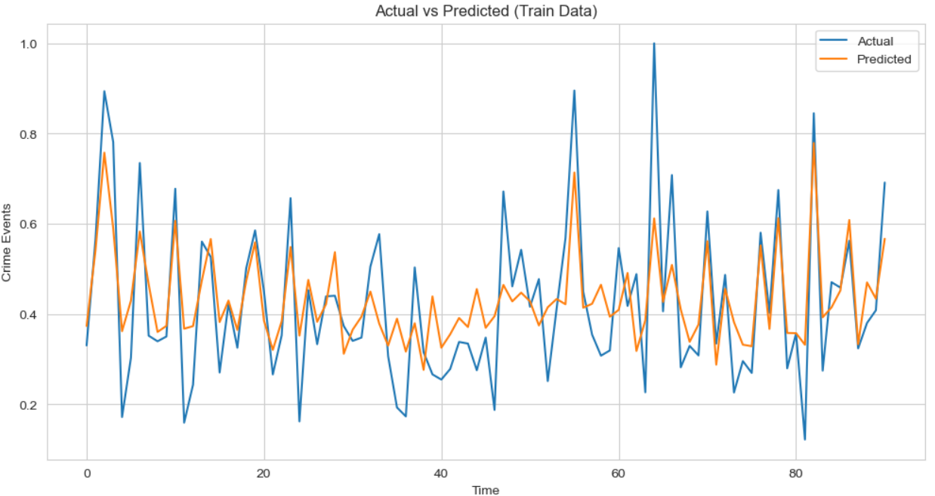
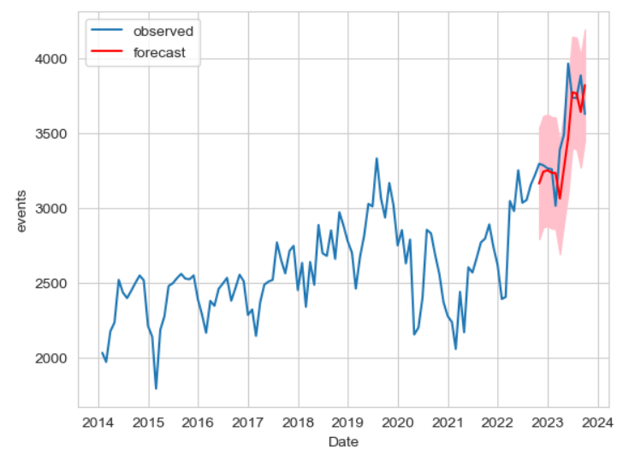
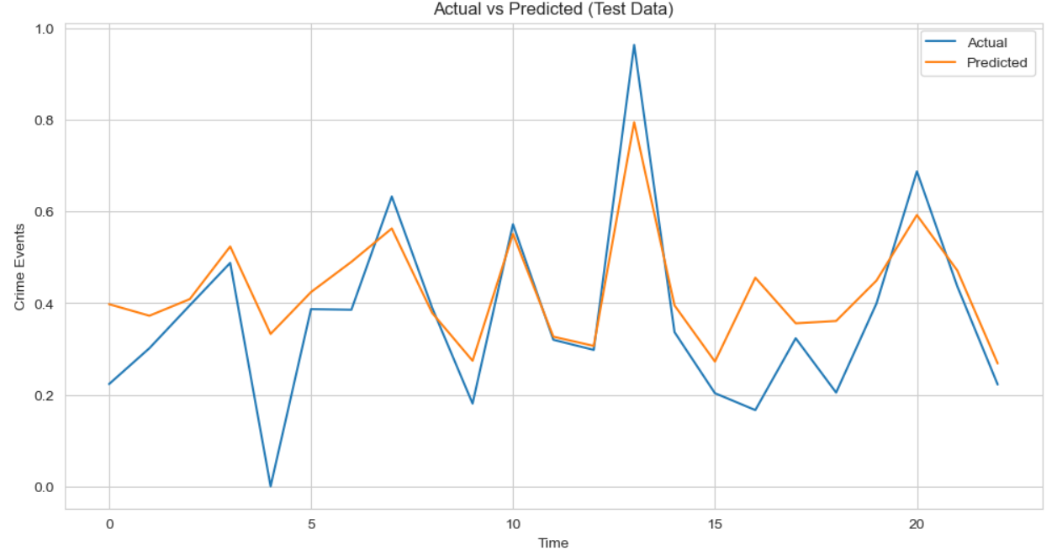
Time Series Analysis
LSTM (Long Short-Term Memory) Model:
Due to the temporal nature of our data, we've opted to extend our analysis with seasonal ARIMA (SARIMA) and LSTM models.
SARIMAX Model:

Slide 13

Interpretation
Based on the extensive analysis and results obtained from our crime rate analysis project, several key interpretations emerge:
Feature Importance: Identified influential factors contributing to crime rates through feature analysis and correlation studies.
Predictive Modeling Performance: Machine learning models, including Random Forest Classifier, SARIMAX, and LSTM, demonstrated varying performance levels in predicting crime rates.
Temporal Patterns: Time series analysis revealed significant temporal patterns, including seasonality and trends, in crime rate data.
Model Interpretability: Models like Random Forest Classifier and SARIMAX provided insights into factors driving crime rates, aiding policymakers and law enforcement in developing targeted interventions.

Slide 14
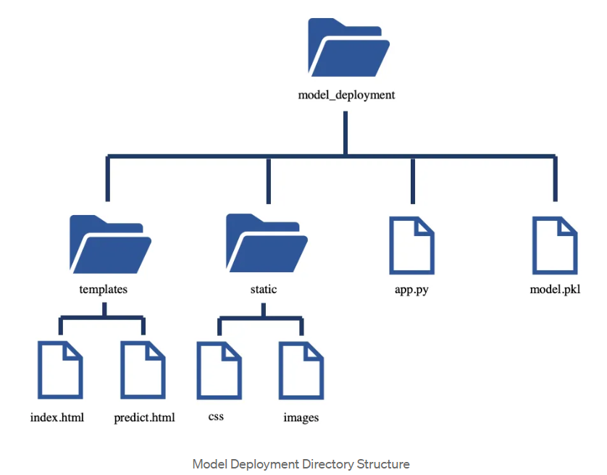
Model Deployment
Model Selection: Chose Random Forest Classifier for its superior accuracy.
Deployment Process: Created dedicated directory, encapsulated model into pickle file, and developed Flask application for user interaction.
Flask Application: Empowers users to input values for crime class predictions through an interactive web page.
Source: https://medium.com/@agulyamova/deploying-classification-model-with-flask-1a694d3534a2
Notes:
app.py — application file that receives the user input data, makes a prediction based on input and sends the result back to the user.
model.pkl — is the pkl file that stores trained Random Forest Classifier model to predict Major Crime Class Category.
templates — directory that stores the index.html file with user input form and predict.html file with model result page.
static — directory with CSS files to improve graphics of the webpage and image files.

Slide 15
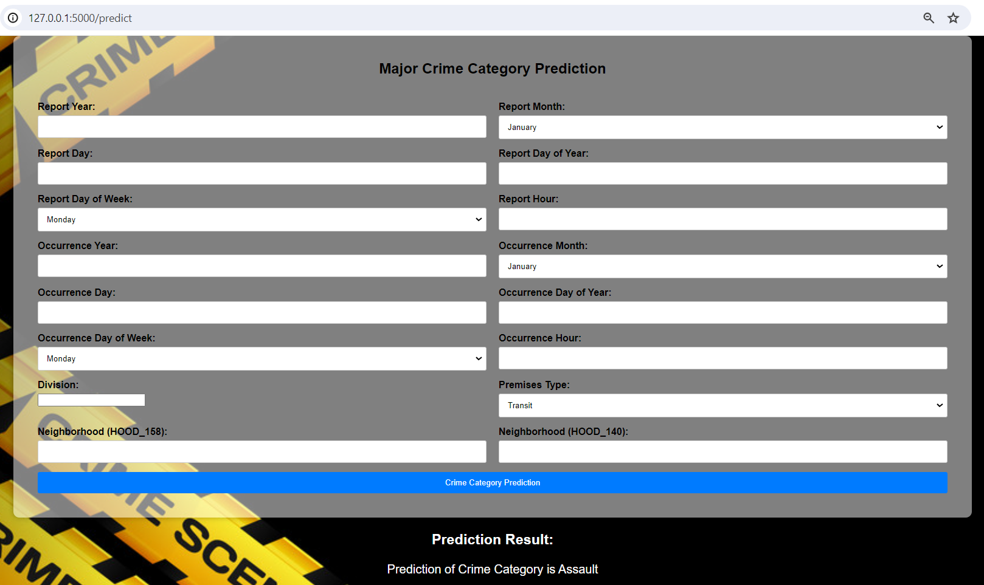
Model Prediction & Results

Slide 16
Conclusion
Our crime rate analysis project epitomizes the essence of data science, blending curiosity, methodical exploration, and analytical prowess to unravel hidden insights and empower decision-makers.
Key findings include valuable insights into crime patterns, promising predictive performance from models like Random Forest Classifier, SARIMAX, and LSTM, and actionable insights for targeted crime prevention strategies.

Slide 17


Be Safe and Thank You!

